Slide 1
OCR Demo

Slide 2

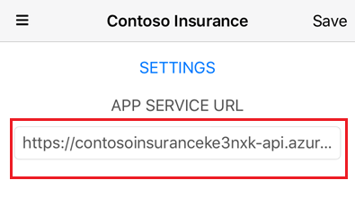
1. Open Mobile app. 2. Click Settings icon, and then set the APP SERVICE URL.

Slide 3
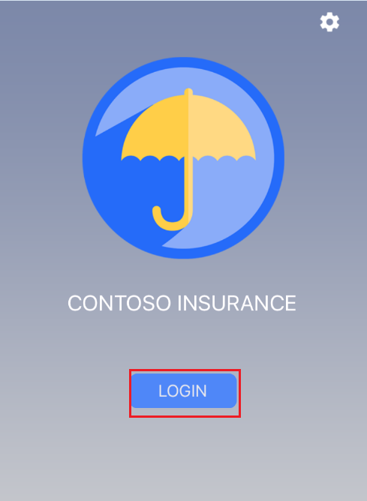
3. Click LOGIN button.

Slide 4
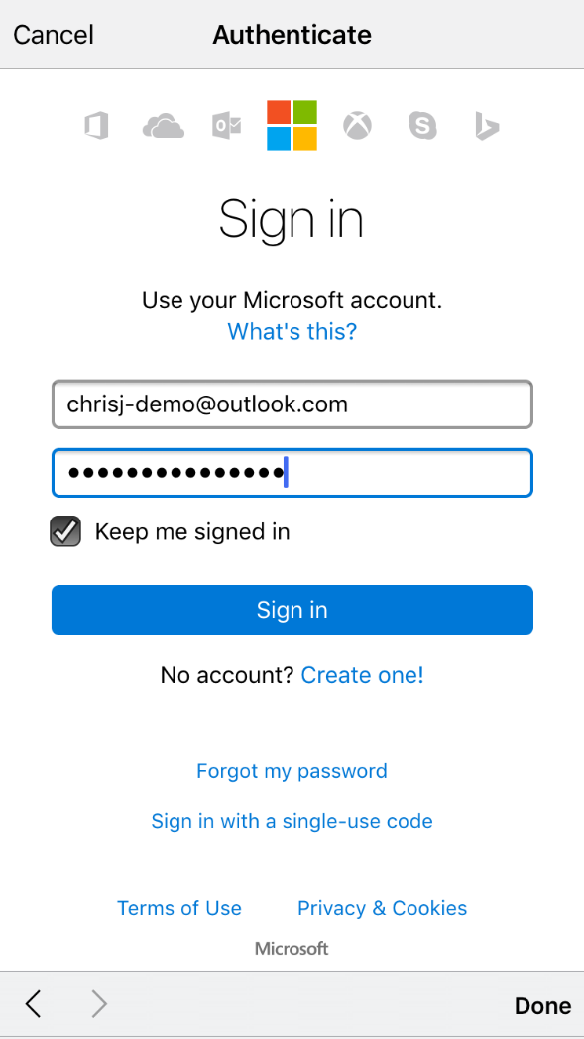
4. Enter customer account and Signin

Slide 5
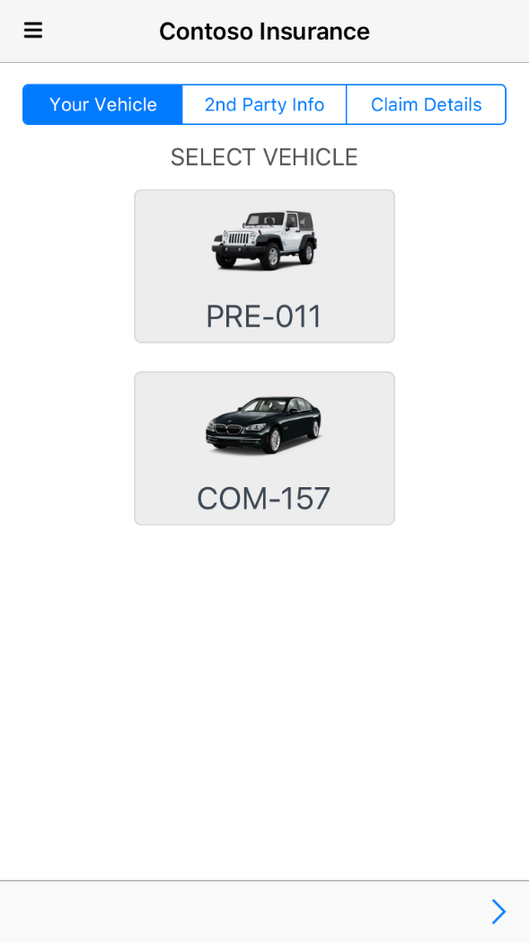
5. Select your vehicle and click next icon.

Slide 6
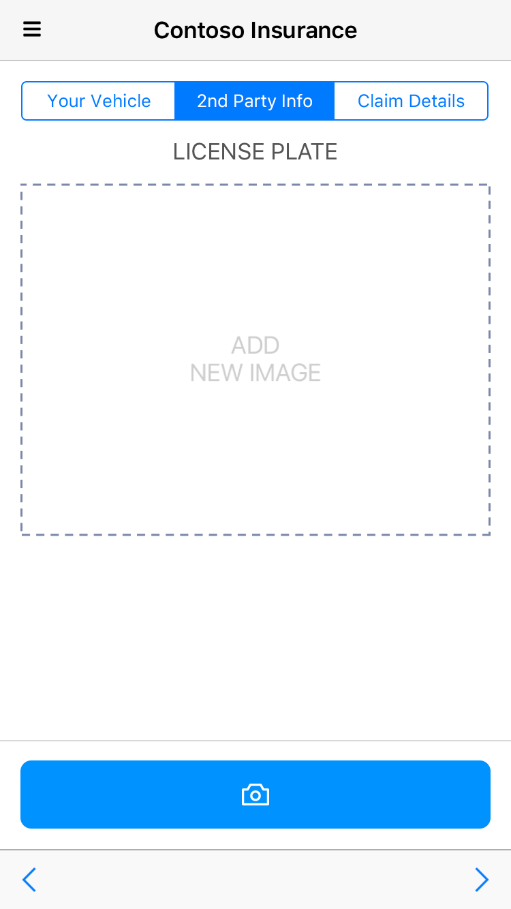
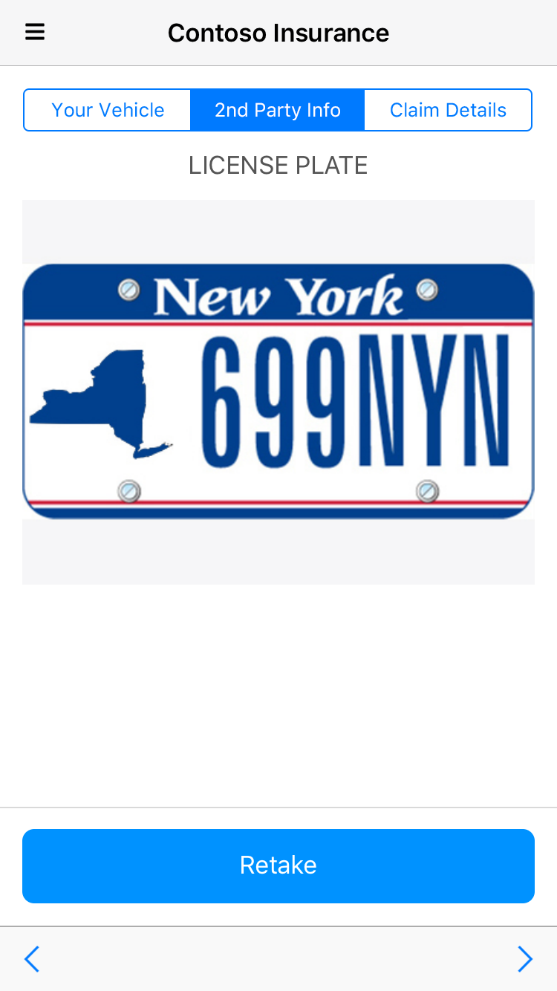
6. Select a 2nd party License Plate.

Slide 7

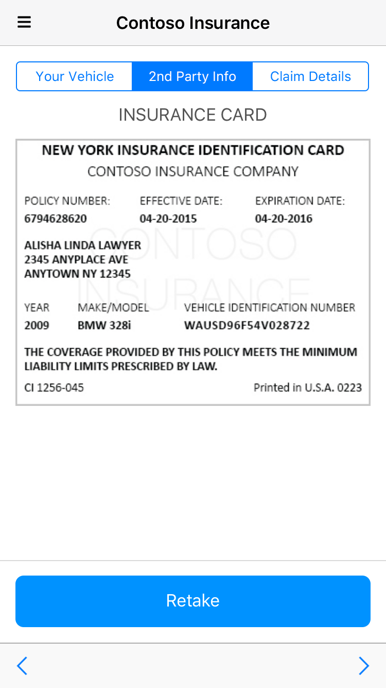
7. Select the 2nd party Insurance Card.

Slide 8
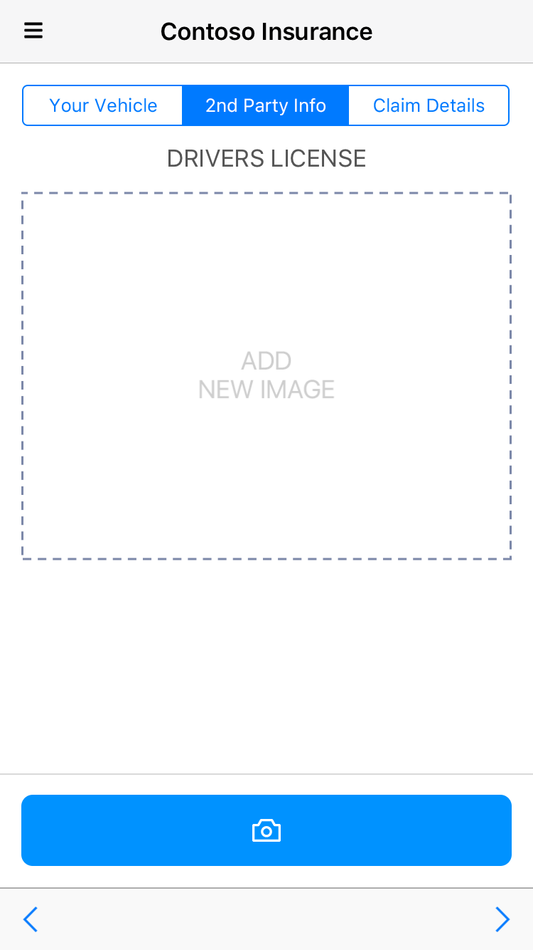
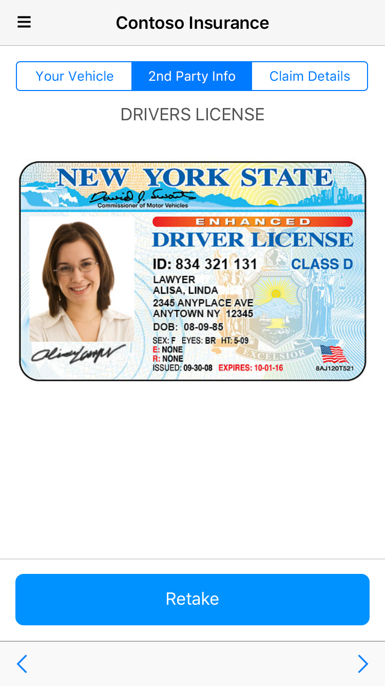
8. Select the 2nd party Driver License.

Slide 9
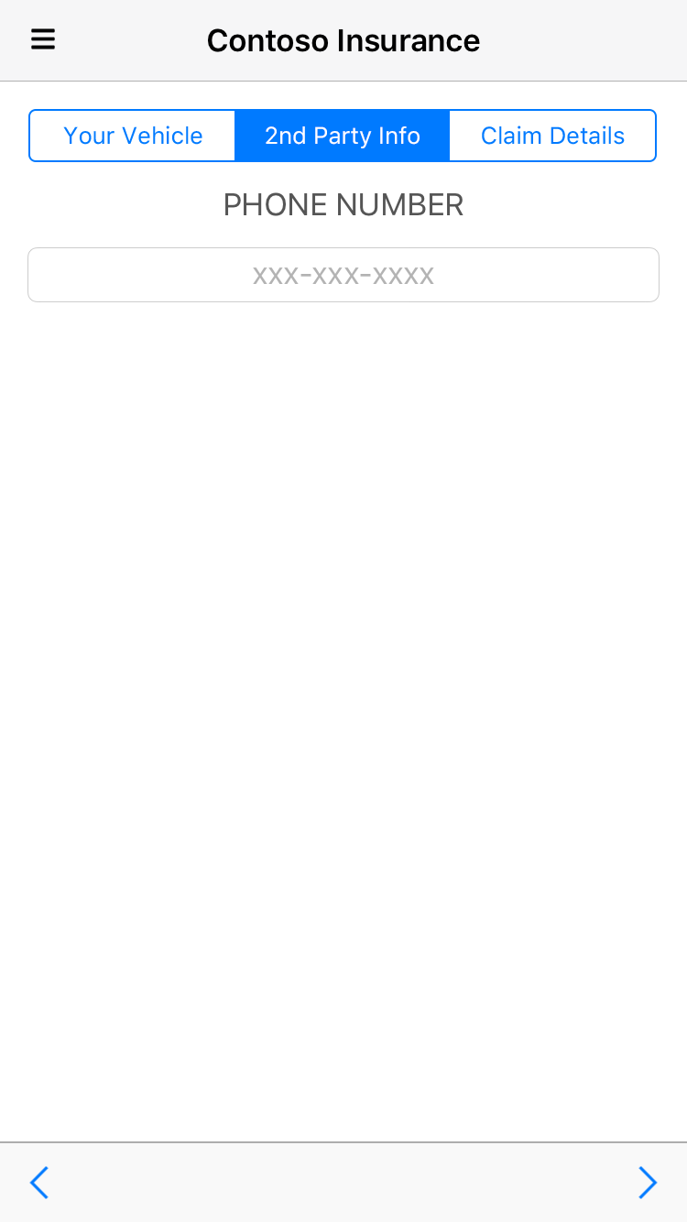
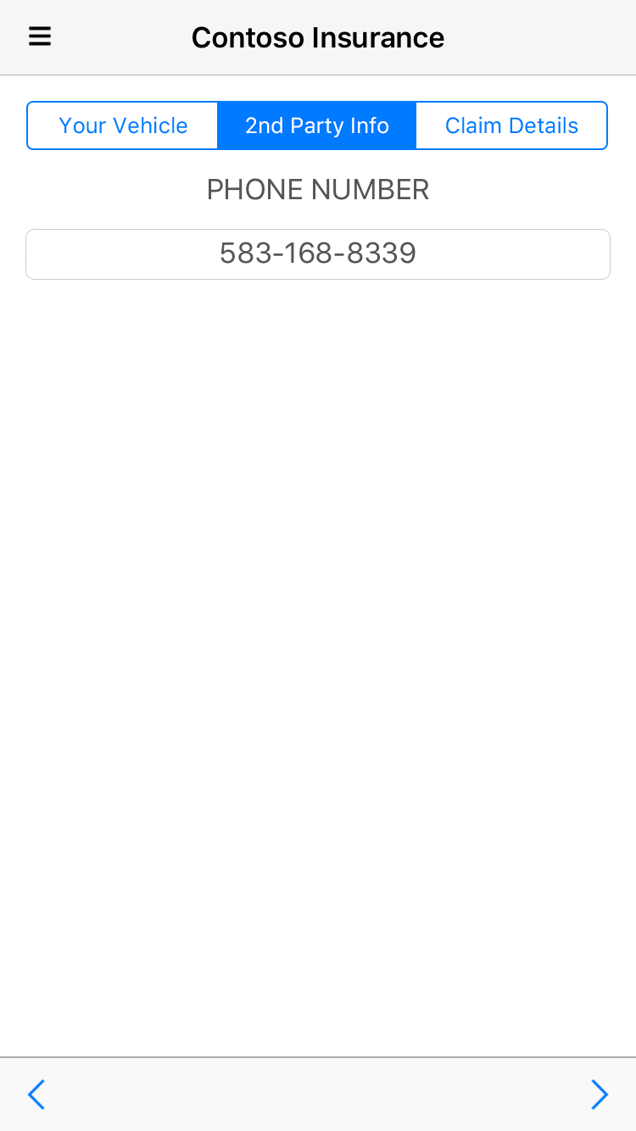
9. Enter Phone Number for the 2nd party.

Slide 10
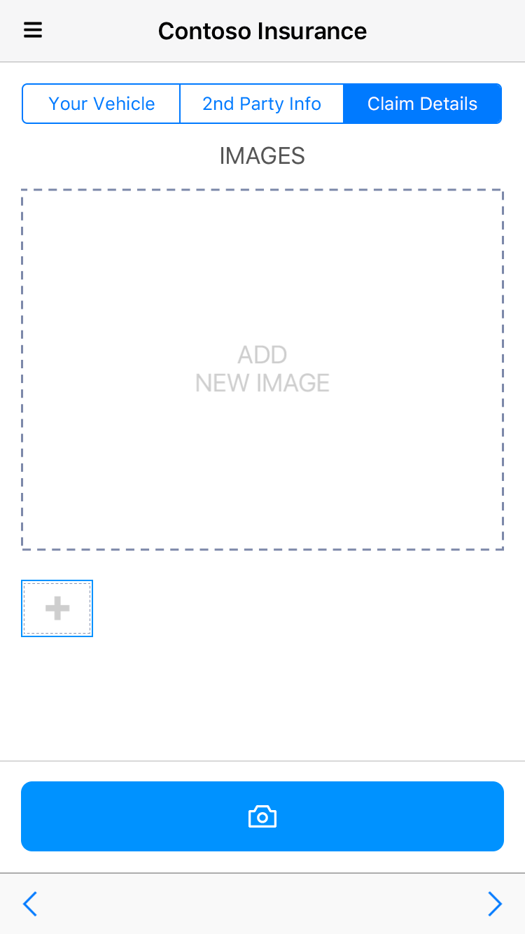
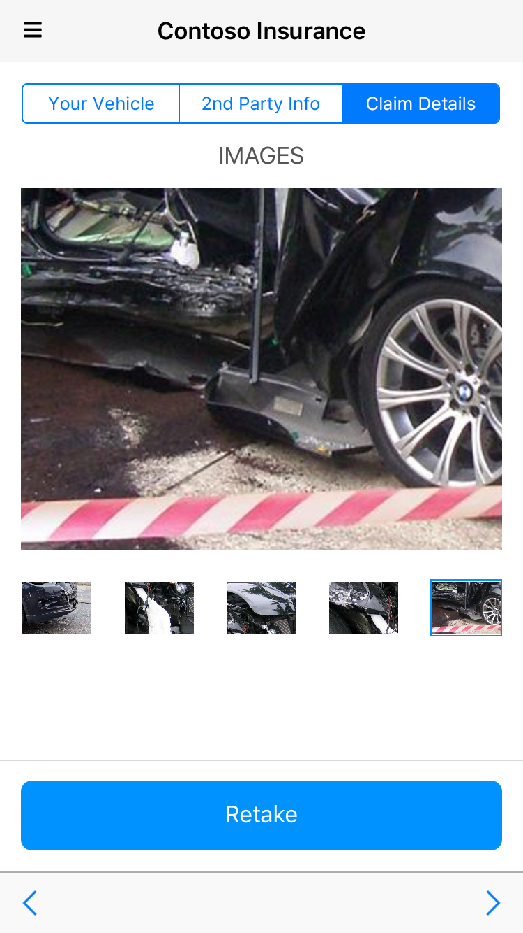
10. Add Claim Images

Slide 11
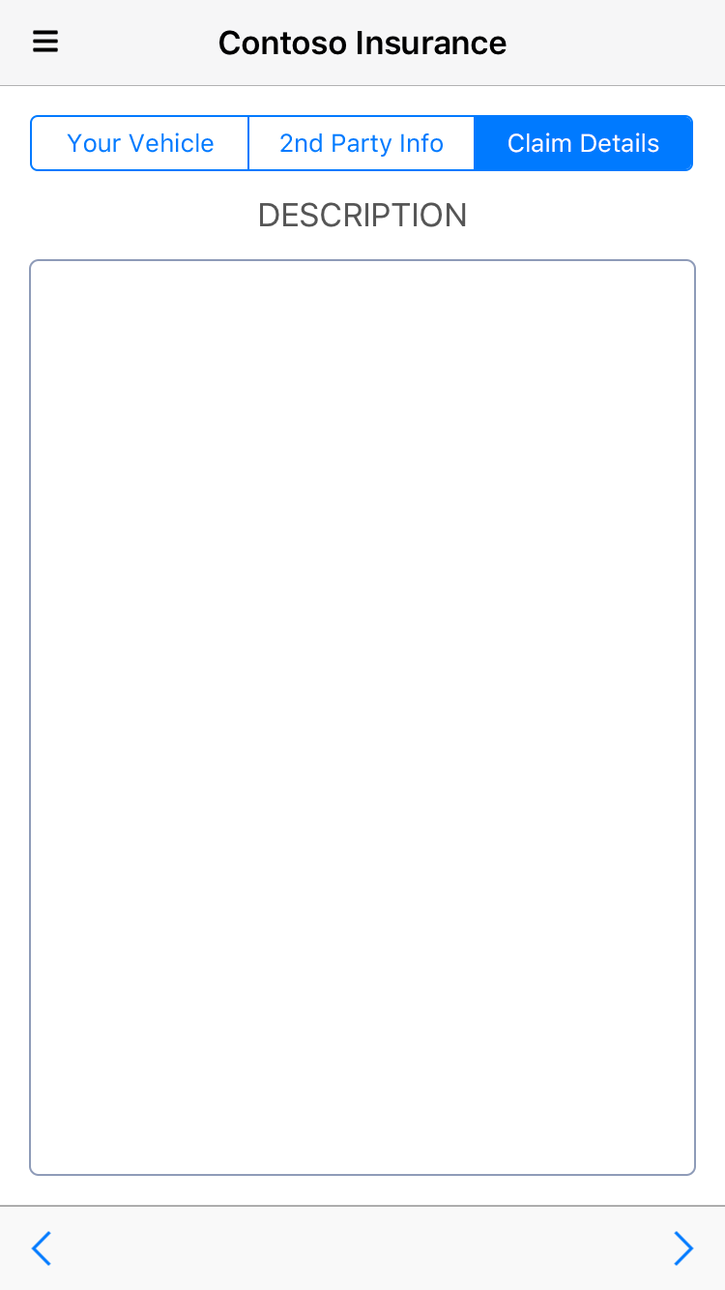
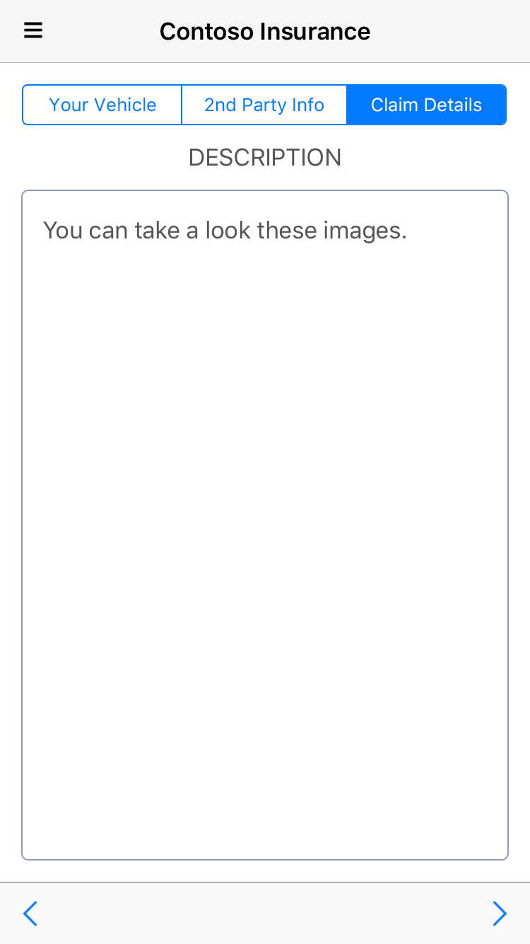
11. Add Claim Description.

Slide 12
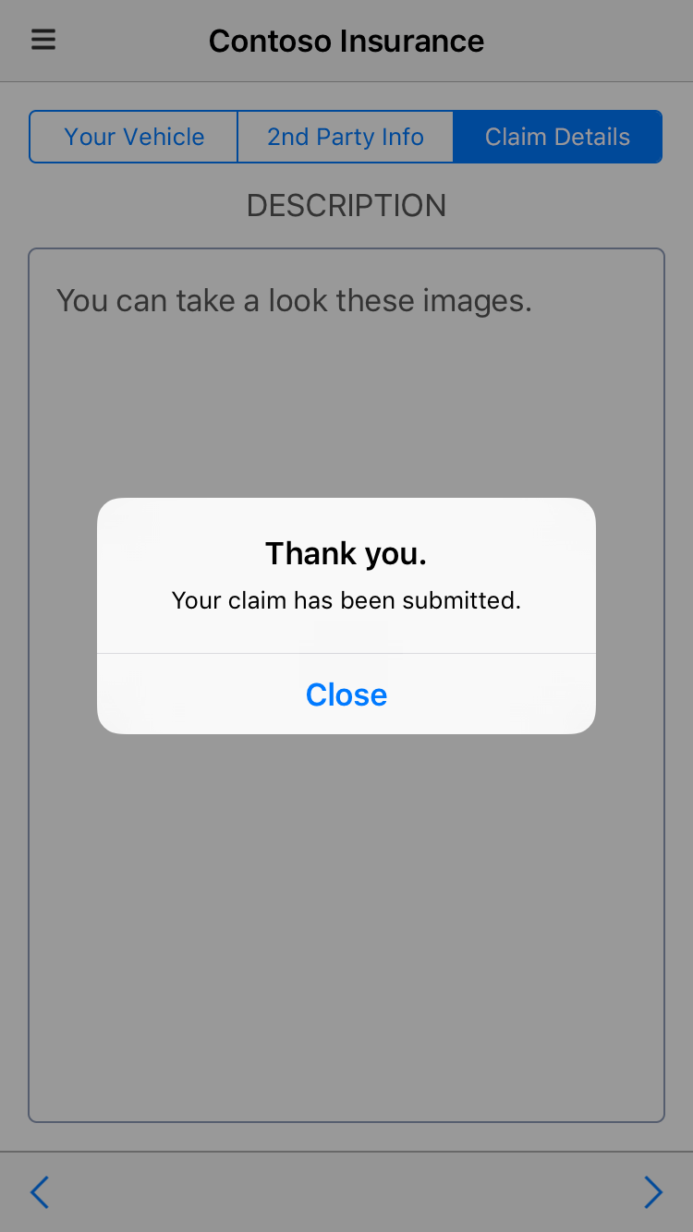
11. Submit the Claim.

Slide 13
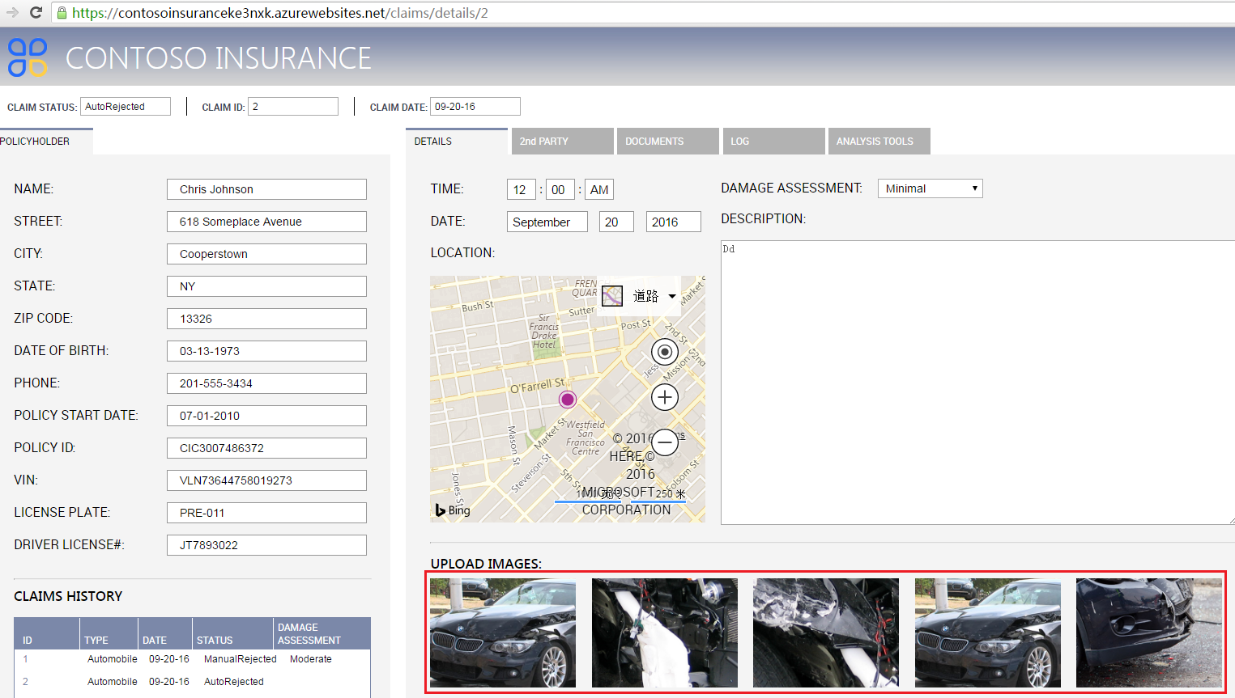
12. Open web app and check the Claim images in Details tab.

Slide 14
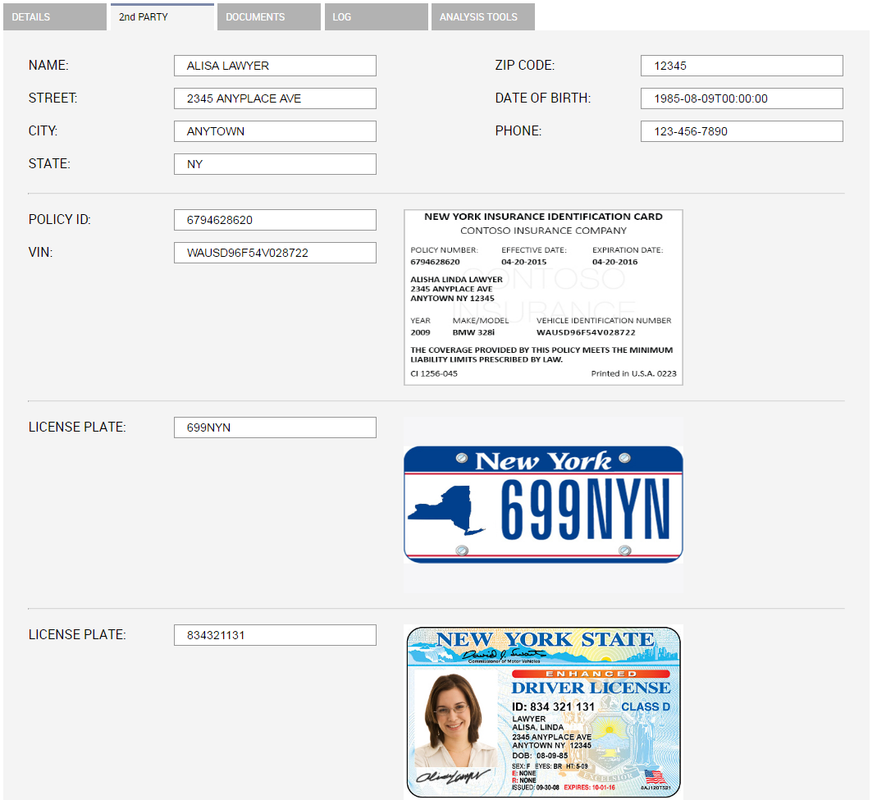
13. All 2nd Party information are displayed on 2nd Party tab.

